Slide 1
ChariTable
Choose to give with confidence

Slide 2
Overview

Slide 3
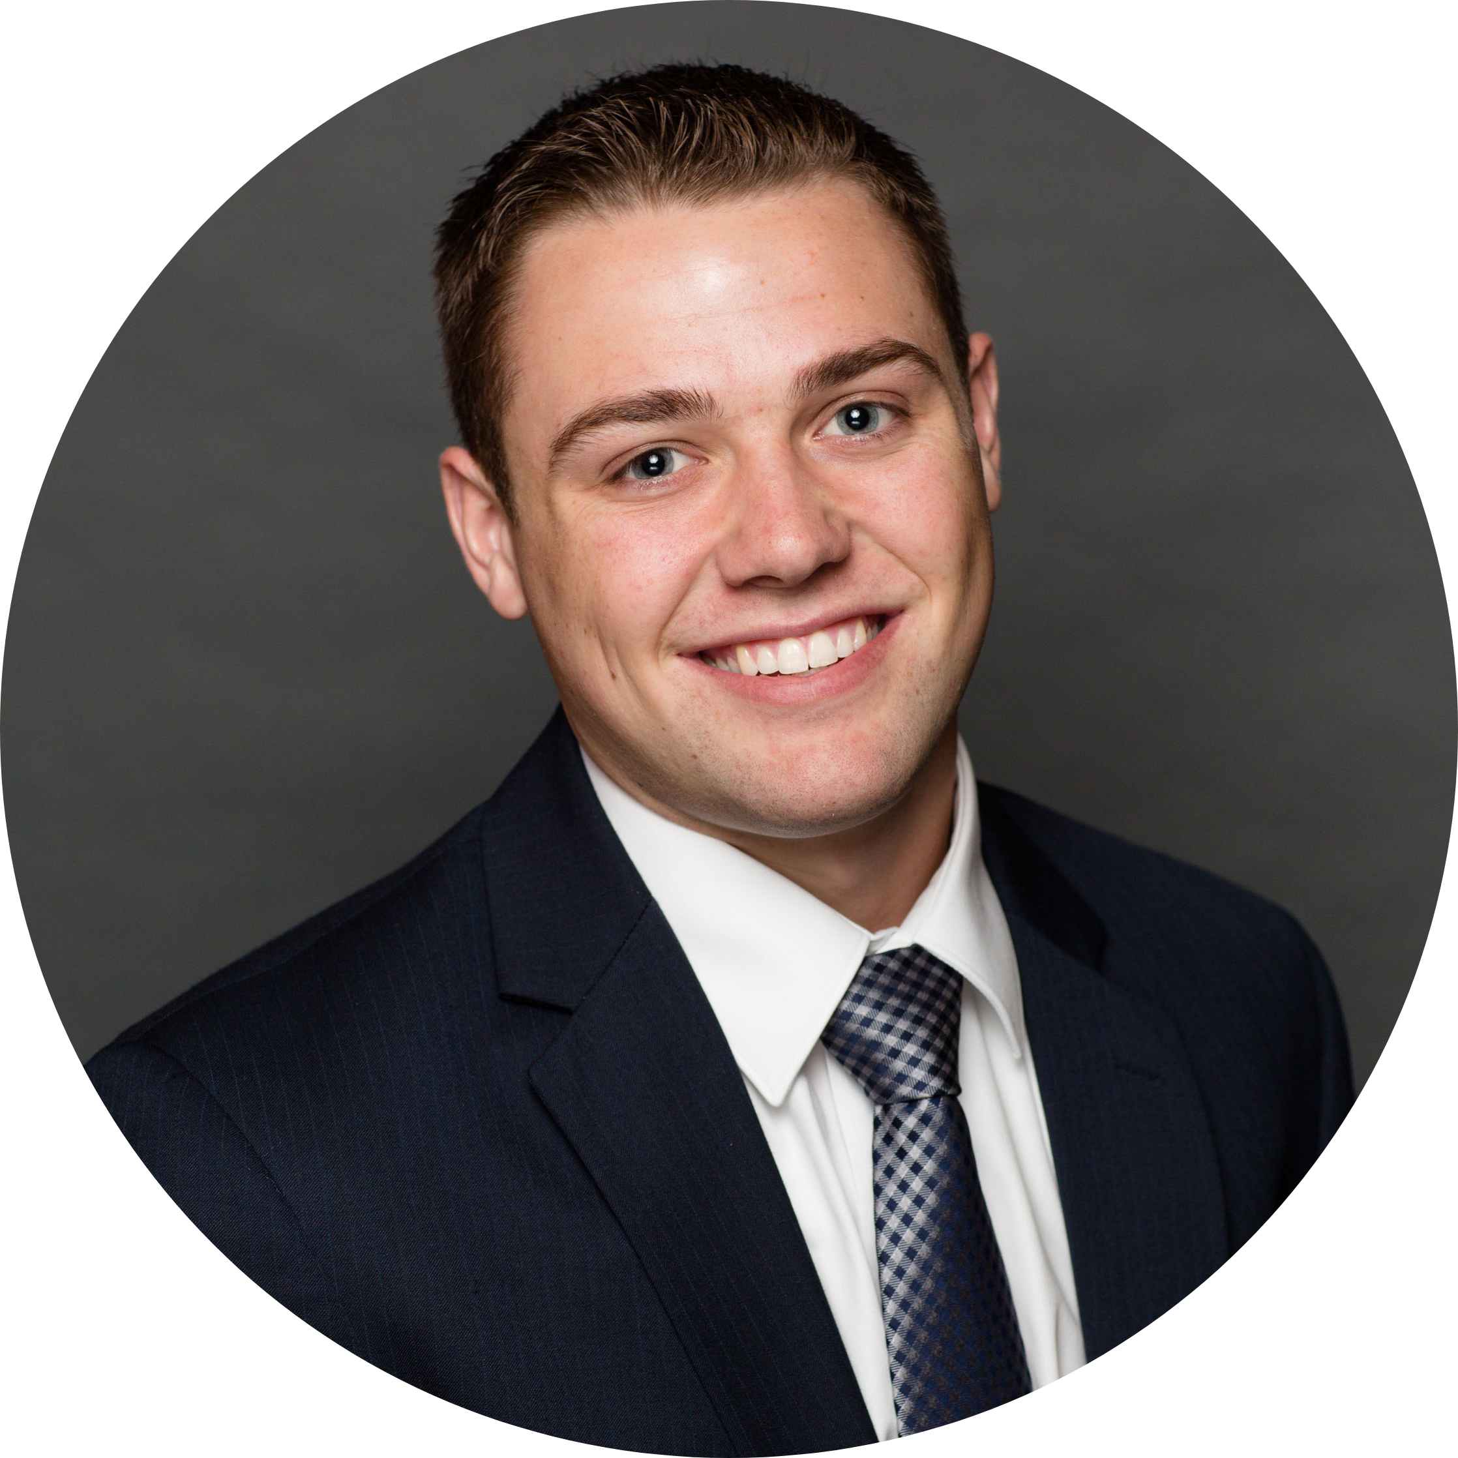
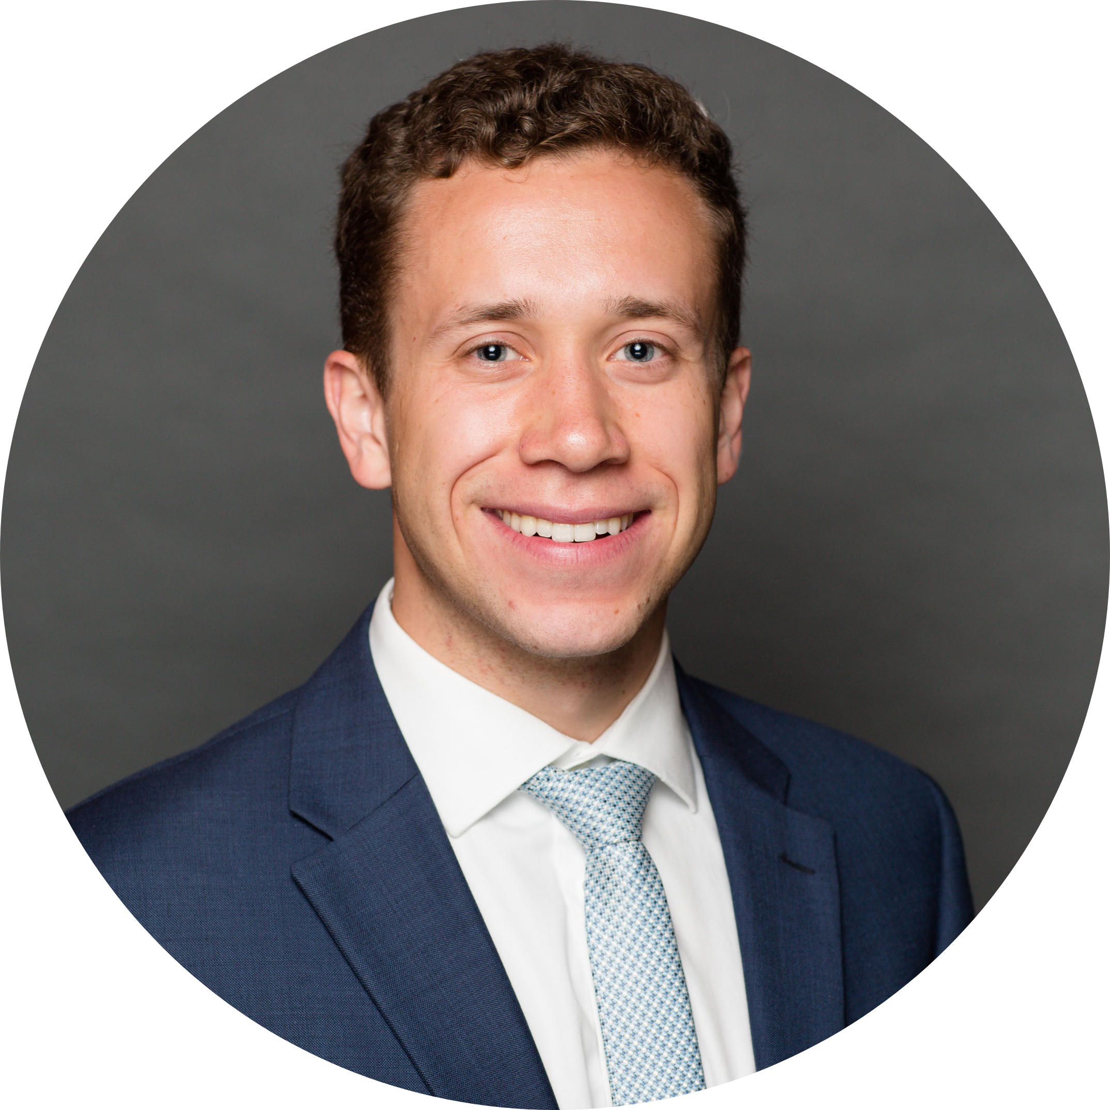
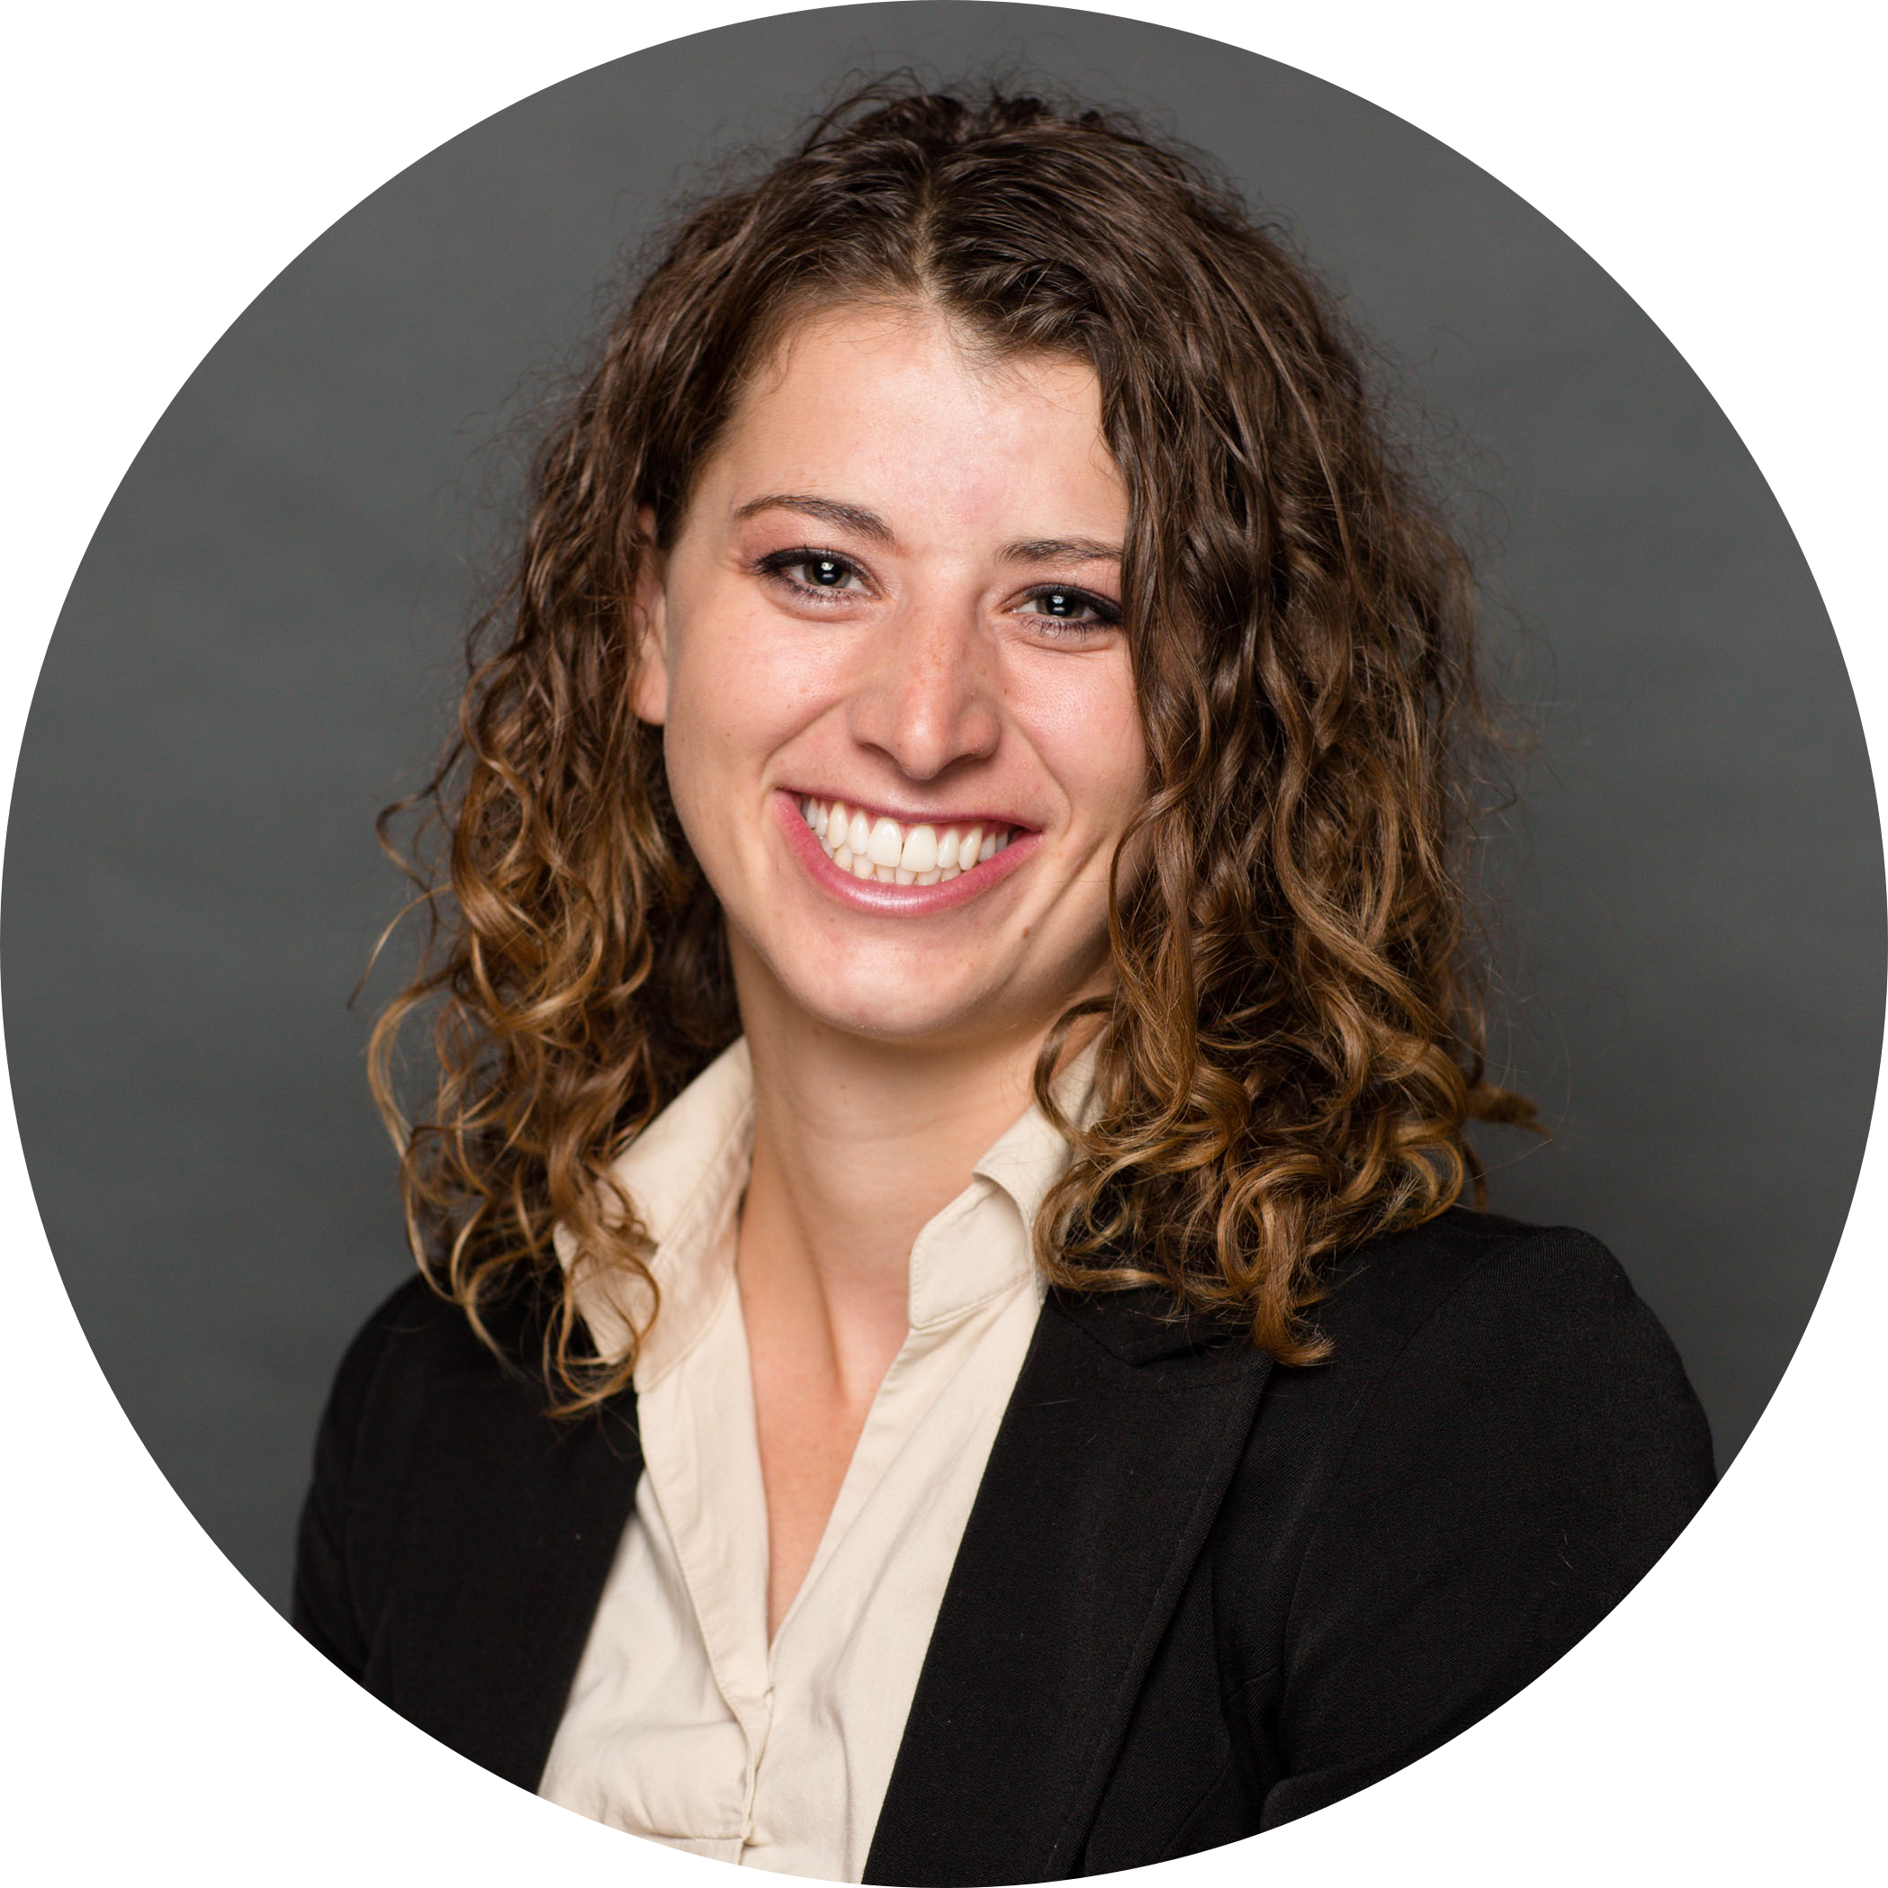

The Team
Jeffrey Mohler
McKay Matheson
Bonnie McDougal
Josh Kartchner

Slide 4
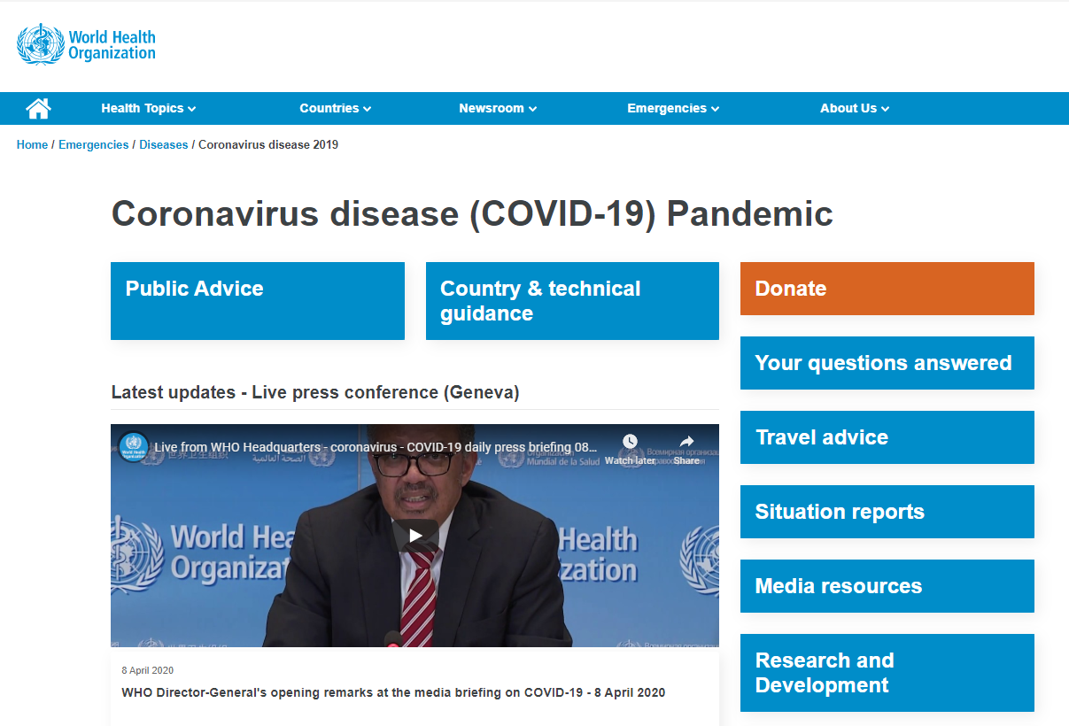
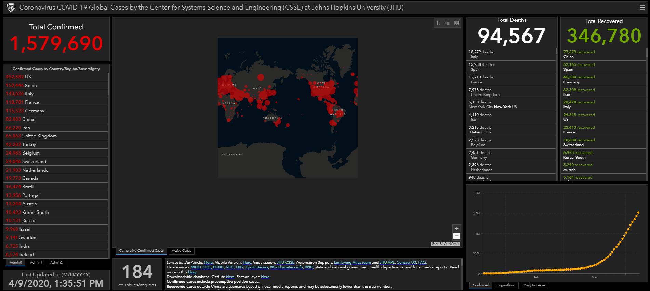

COVID-19
Overview
Image sources: https://www.who.int/emergencies/diseases/novel-coronavirus-2019
https://coronavirus.jhu.edu/map.html

Slide 5


Pain Points
Creating Successful Campaigns
Detecting Fraudulent Campaigns

Slide 6

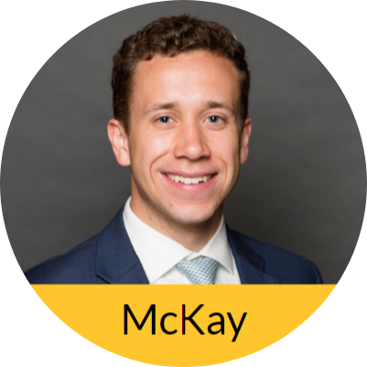
Project Objectives
Evaluate Data
Determine Success Measures
Develop Relevant Features

Slide 7
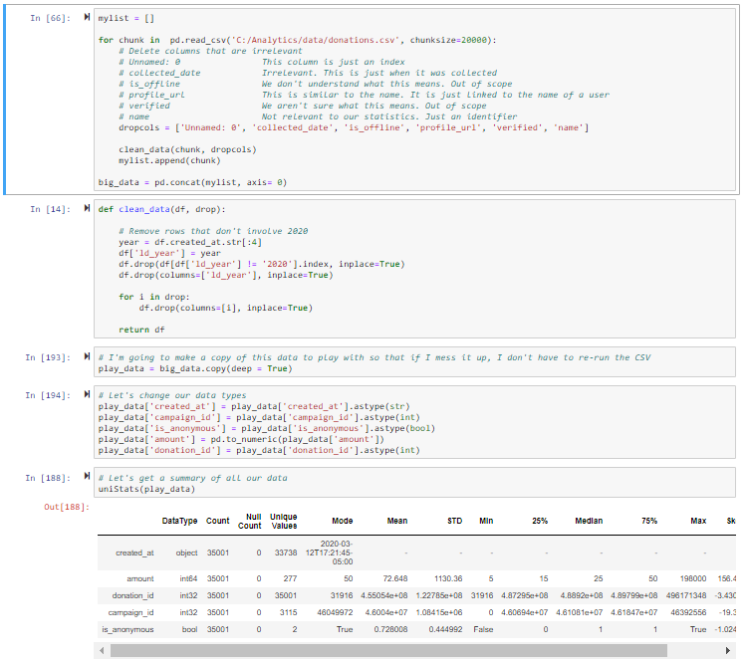
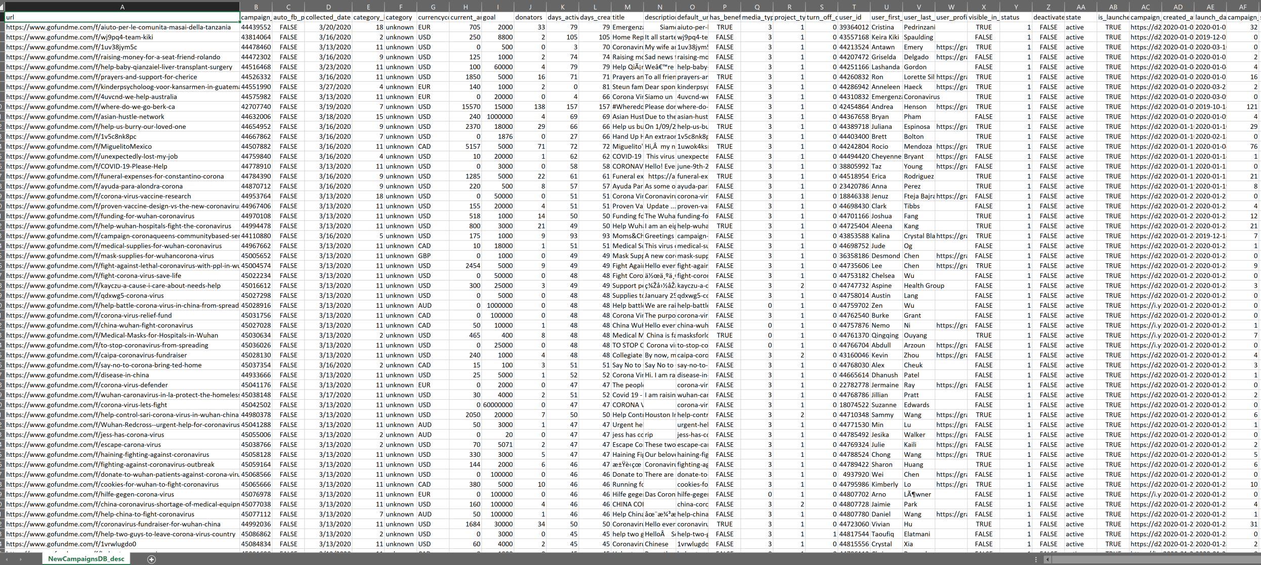
Data
Cleaning

Slide 8
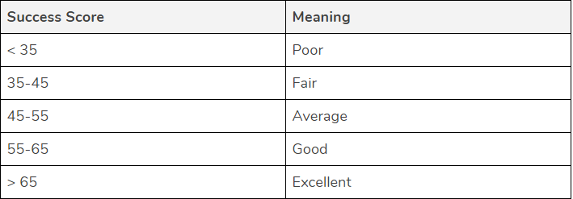
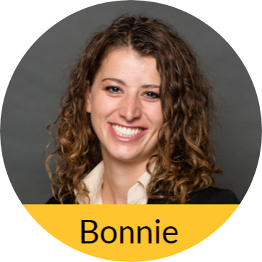
Success Measures
To measure success in our prediction model, we created a calculated field titled success score. This score is the average T-score of two metrics:
Donation amount per donor
Percent of goal reached in collections

Slide 9
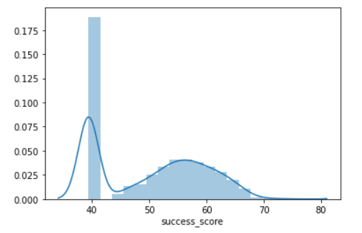
Success Measures
Success scores in our data set are normally distributed except for a massive amount of campaigns that have not raised any money yet.

Slide 10
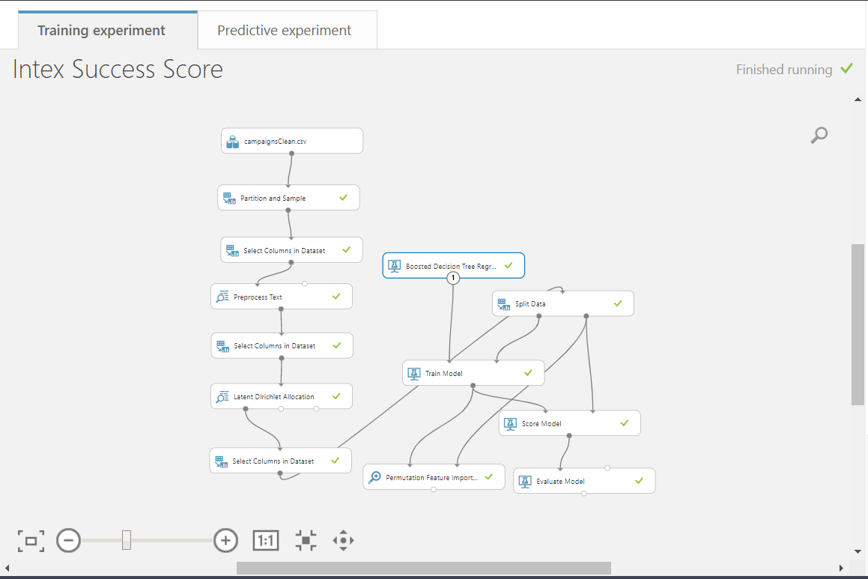
Data
Pipeline
Latent dirichlet allocation
Boosted decision tree model
R-squared: 0.247

Slide 11

Website Walkthrough
http://checkcharitable.herokuapp.com/

Slide 12

Security
User logins
Cross-Site Scripting
SQL Injection
Confidentiality
HTTPS
Database Security

Slide 13

Recommendations
Use the predictor feature for new campaigns
Target weak campaigns

Slide 14
Thank You

